Slide 1

Network Layer: IPv4 Routing
Lecture 10 | CSE421 – Computer Networks
Department of Computer Science and Engineering School of Data & Science

Slide 2
Objectives
Static Routing
Standard static routing
Directly Attached / Connected
Next Hop / Recursive
Default Routing

Slide 3
Learning About Networks
A router can learn about remote networks in one of two ways:
Manually - Remote networks are manually entered into the route table using static routes.
Dynamically - Remote networks are automatically learned using a dynamic routing protocol.
Notes:
‹#›
6.1.1.1

Slide 4
Static Route
A static route is created, maintained, and updated by a network administrator, manually.
A static route to every network must be configured on every router for full connectivity.
Notes:
If there is no dynamic routing protocols

Slide 5
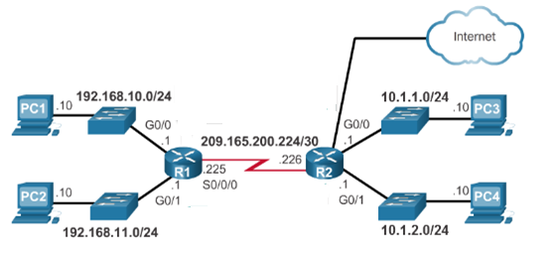
Learning About Networks
Table of R1
Network | Exit Int
192.168.10.0/24 | G0/0
192.168.11.0/24 | G0/1
209.165.200.224/30 | S0/0/0
Table of R2
Network | Exit Int
10.1.1.0/24 | G0/0
10.1.2.0/24 | G0/1
209.165.200.224/30 | S0/0/0
220.20.20.0/30 | G0/2
20.20.20.0/30
Directly connected
Directly connected
10.1.1.0/24
S0/0/0
10.1.2.0/24
S0/0/0
192.168.10.0/24
S0/0/0
192.168.11.0/24
S0/0/0
S0/0/1
S0/0/0

Slide 6
Static Route Advantages
Static routing provides some advantages over dynamic routing, including:
Static routes are not advertised over the network, resulting in better security.
Routers not share static routes with each other, thus reducing CPU/RAM overhead and saving bandwidth.
Notes:
‹#›
Advantage of static routing
It is most secure way of routing, since no information is shared with other routers.
It puts no overhead on resources such as CPU or memory.
No routing algorithm or update mechanisms are required. Therefore, extra resources (CPU and memory) are not required.
It is easy to implement.

Slide 7
Static Route Disadvantages
Static routing has the following disadvantages:
Initial configuration and maintenance is time-consuming.
Configuration is error-prone, especially in large networks.
Administrator intervention is required to maintain changing route information.
Does not scale well with growing networks; maintenance becomes cumbersome.
Requires complete knowledge of the whole network for proper implementation.
Notes:
‹#›
6.1.1.2

Slide 8
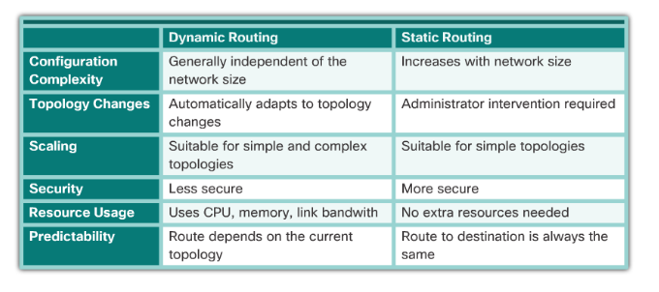
Comparison

Slide 9
Static Route Applications : Types
Static Routes are often used to:
Connect to a specific network
Provide a Gateway of Last Resort for a stub network – Default Gateway
Summarize routing table entries
Create a backup route in case a primary route link fails
Notes:
‹#›
Reduce the number of routes advertised by summarizing several contiguous networks as one static route

Slide 10
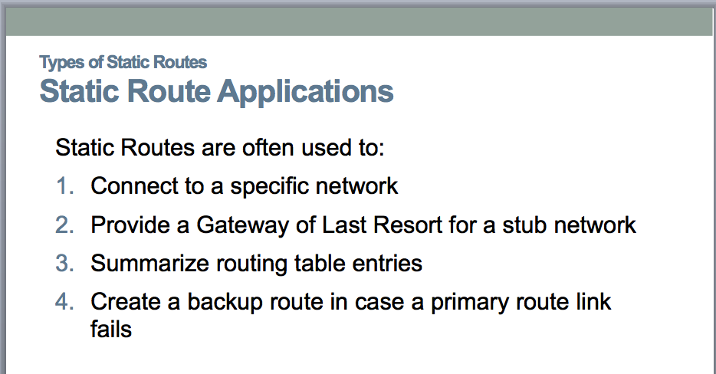
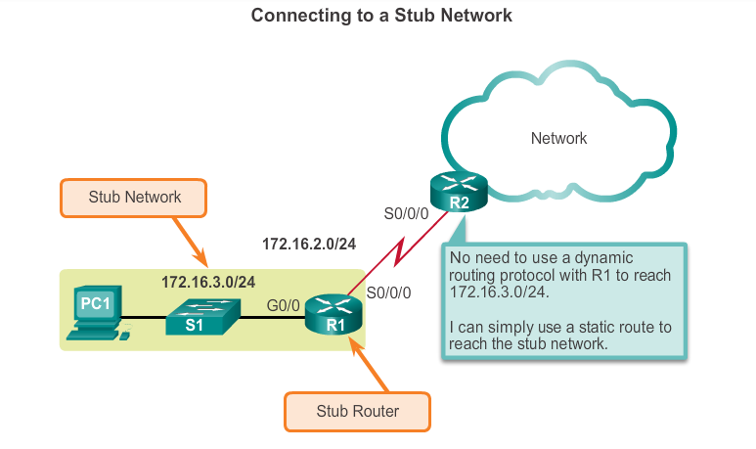
Standard Static Route
Static route can be used to connect to a specific network ( like for example a stub network)
Notes:
‹#›
6.1.2.2

Slide 11
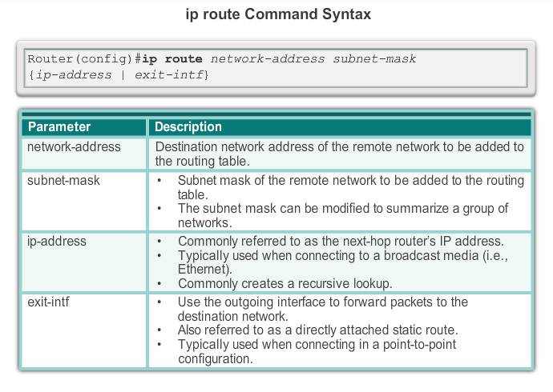
ip route Command
Next hop
Notes:
‹#›
6.2.1.1

Slide 12
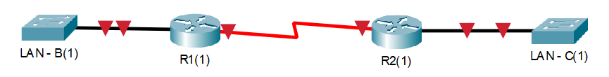
Next Hop Options
Directly attached/connected static route
Only the router exit interface/port name (i.e. s0/0) is specified.
Next-hop/Recursive lookup static route
Only the next-hop IP address (i.e. 2.2.2.2) is specified.
**Note: Port labels:
Each port has a name (s0/0 or f0/0 or g0/0 or etc.) and an IP address (1.2.3.4 or etc.)
.1
2.2.2.0/30
.2
S0/0
S0/1
**Configuring R1(1) towards LAN – C
***All settings are done from R1(1)’s perspective

Slide 13
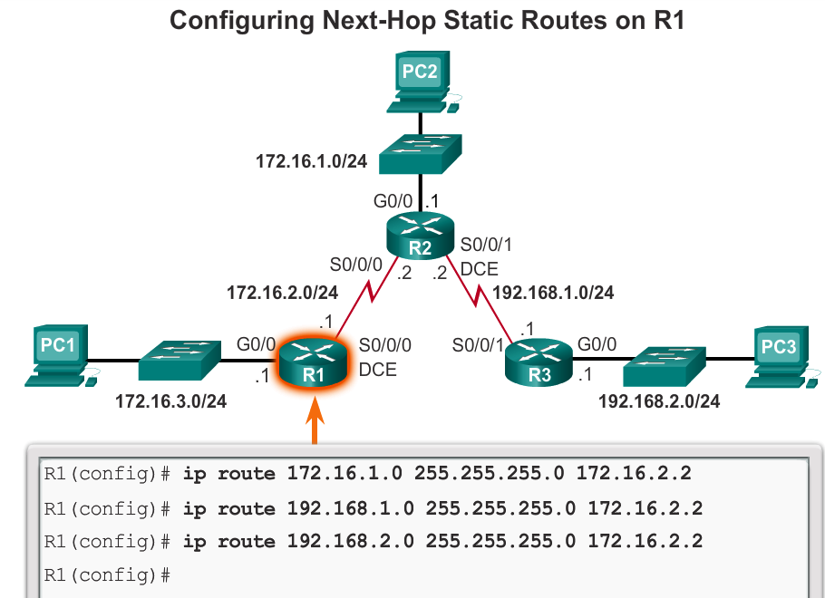
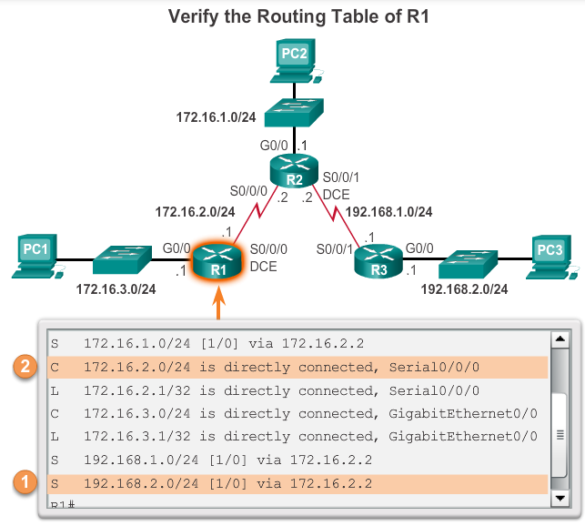
Standard Static Route using next hop IP address
Recursive Lookup
Notes:
When a packet is destined for the 192.168.2.0/24 network, R1:
1. Looks for a match in the routing table and finds that it has to forward the packets to the next-hop IPv4 address 172.16.2.2.
2. R1 must now determine how to reach 172.16.2.2; therefore, it searches a second time for a 172.16.2.2 match.

Slide 14
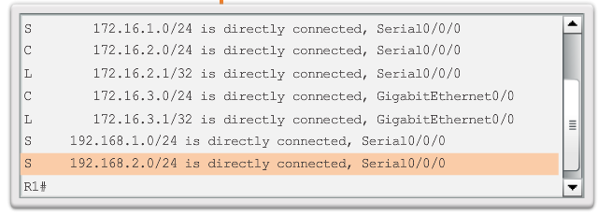
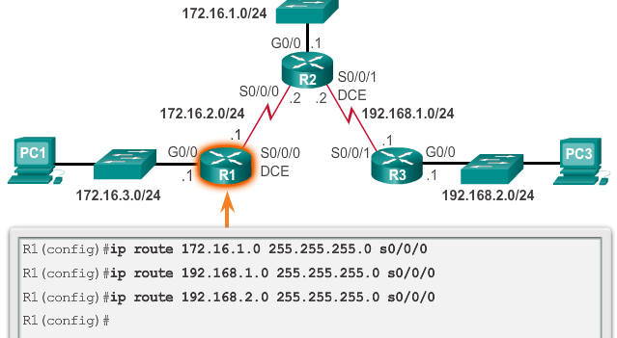
Standard Static Route using Exit Interface

Slide 15
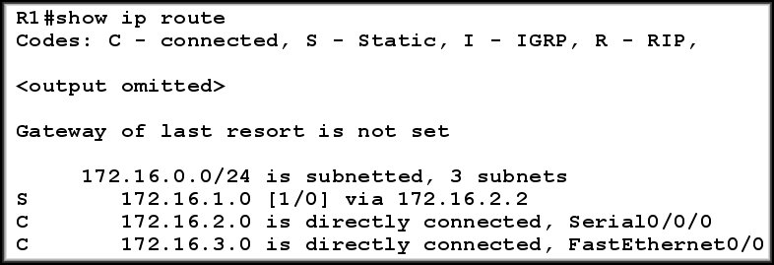

Static Route : The line and AD explained
Type of route:
S - Static
Destination Network
Cost of Path
Next Hop IP
Or, Exit Interface
Or, Fully Specified
Administrative
Distance
Static Routing table record if it was configured with Exit Interface
NOTE : AD of Static Routes is 1 and AD of Directly Connected Routes is 0

Slide 16
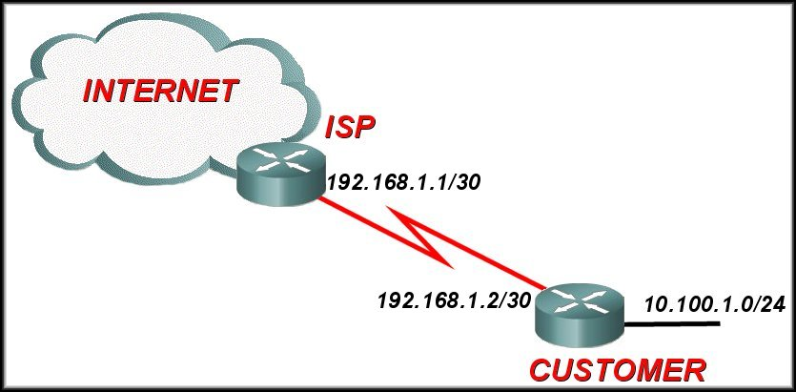
Default Static Routing
A default path to send all IP packets
when no other routes in the routing table match the packet destination IP address.
when a router has only one other router to which it is connected. This condition is known as a stub router.
Uses a special network address as destination: 0.0.0.0/0
Has a subnet mask of 0. Meaning, it will check zero bits and hence it will match all IPs!
Conventionally, always points towards the border/ISP
Router.
Configuring a default static route creates a Gateway of
Last Resort.

Slide 17
Configuring Default Static Route
**Note: A static route usually always points towards the specific network, while default static route points towards outside the network where a border router is connected to the internet
ip route 10.100.1.0 255.255.255.0 192.168.1.2
ip route 0.0.0.0 0.0.0.0 192.168.1.1

Slide 18
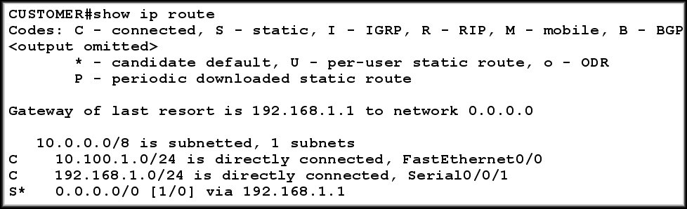
Verifying Default Static Route

Slide 19
Commands to Verify Static Routes
Along with ping and traceroute, useful commands to verify static routes include:
show ip route
show ip route static
show ip route network

Slide 20
Objectives
Dynamic Routing
Routing Algorithms
Global - Link State
Decentralized - Distance Vector

Slide 21

Routing Algorithms
Given a set of routers and links connecting the routers.
Routing algorithm finds a “good” path from the source to destination router.
Good path = Least cost path

Slide 22
Autonomous Systems
Internet is divided into autonomous systems.
An autonomous system (AS) is a group of networks and routers under the authority of a single administration.
Routing inside an autonomous system is called intra-domain routing. Routing between autonomous systems is called inter-domain routing.

Slide 23
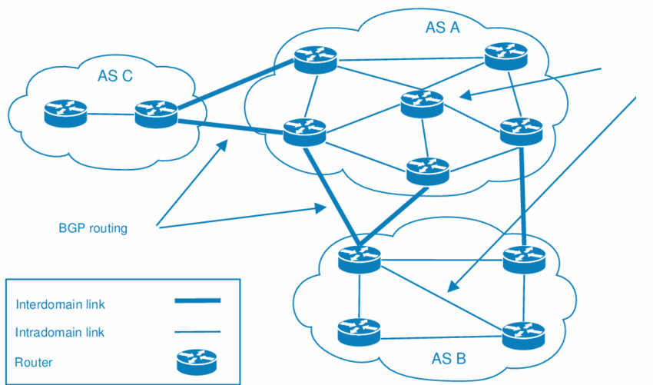
Autonomous Systems
RIP/ OSPF

Slide 24
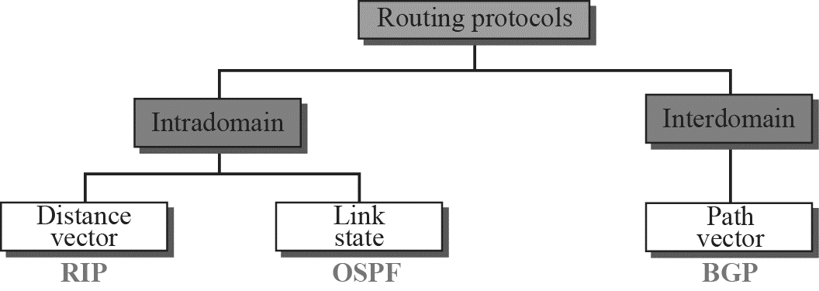
Popular Routing Protocols

Slide 25
Routing Algorithm classification
Global or Decentralized
Global:
all routers have complete topology and link cost info
“link state” algorithms
Decentralized:
router knows physically-connected neighbors, link costs to neighbors
iterative process of computation, exchange of info with neighbors
“distance vector” algorithms

Slide 26
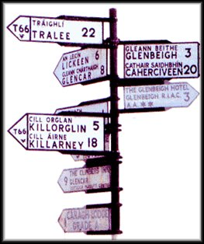
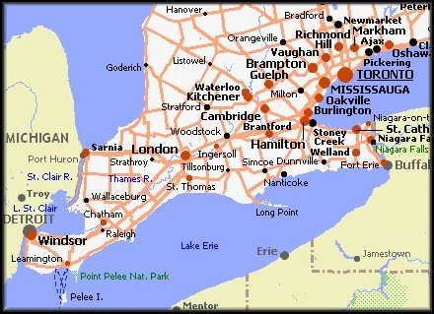
Distance Vector routing protocols are like road signs.
Routers must make preferred path decisions based on a distance or metric to a network.
Link-State routing protocols are more like a road map.
They create a topological map of the network and each router uses this map to determine the shortest path to each network.

Slide 27
Distance vector algorithm
Basic idea:
Each node periodically sends its own distance vector estimate to neighbors
When a node x receives new DV estimate from neighbor;
It updates its own DV using B-F equation
Notes:
‹#›

Slide 28
Operation of Distance Vector
Periodic Updates:
Periodically broadcast the entire routing table to each of its neighbors (RIP – every 30 seconds).
Inefficient
Router is only aware of the:
Network addresses of its own interfaces.
Network addresses the neighbors running the same routing protocol.
Notes:
Inefficient: Updates consume bandwidth and router CPU resources.
Periodic updates are always sent even there have been no changes for weeks or months.

Slide 29

Link-State Routing Protocols
Centralized Routing Algorithm
computes the least-cost path using complete, global knowledge about the network.
Link-state routing protocols are also known as shortest path first protocols
The Link state routing protocol uses Dijkstra's algorithm which is used to find the shortest path from one node to every other node in the network.
While they have the reputation of being much more complex than distance vector, the basic functionality and configuration of link state routing protocols are not complex.

Slide 30
Link-State Routing Process
5 Step Process
Each router learns about its own directly connected networks.
Each router is responsible for contacting its neighbors (exchange Hello packet) on directly connected networks.
Each router builds a link-state packet (LSP) containing the state of each directly connected link.
Each router floods the LSP to all routers, who then store all LSPs received in a database.
Each router uses the LSPs to construct a database that is a complete map of the topology and computes the best path to each destination network.
Notes:
How does a link-state routing protocol work?
How does a link-state routing protocol work?

Slide 31
Comparison
 | Distance Vector | Link State
Network view | Topology knowledge from the neighbor point of view | Common and complete knowledge of the network topology
Best Path Calculation | Based on fewest number of hops | Based on the link cost
Updates | Full routing table | Link State Updates
Algorithm | Bellman-Ford | Dijsktra
CPU and Memory | Low utilization | Intensive
hierarchical Structure | No | Yes
Convergence time | Moderate | Fast

Slide 32
The End

